Slide 1
Mrs. M^{c}Kee 2018/2019 RM 114

Slide 2
Course Description
In partnership with ASU, the COMPUPOWER program will expose students to STEM standards and integrate culturally responsive curriculum.
COMPUPOWER will further develop students’ non-cognitive skills, use of technology for research and problem-solving, and help them become change-makers in their community.

Slide 3
Course Objectives
You will learn how to manipulate the latest technologies in digital media, game development, and virtual worlds.
You will learn how to become more than gamers or consumers by researching your own unique projects around a social justice theme.
You will develop the skills needed to become the next generation of tech innovators and community leaders.

Slide 4
Semester I Topic Overview and Lessons
Course Introduction; What is Power?
Identity Figures…
Build a Blog/Website
Internet Biases
Learn to Vlog
Conduct Classmate Interviews
Create a Class Website

Slide 5
Course Materials
Binder – 1 ½ or 2 inches
College-ruled loose leaf paper
Pencils or pens and highlighters
Flash Drive**
Composition Notebook**
** Provided

Slide 6
Grading and Assessment
You will receive two grades for the course;
academic and effort
80% Summative Assessments
Activities, Explorations, Major Projects, Tests/Quizzes
20% Class Participation/Homework

Slide 7
Grading Scale
A+ | 97-100% |  | C | 70-79%
A | 90-96% |  | D | 60-69%
B | 80-89% |  | F | 50-59%

Slide 8
Homework
You will be assigned work to complete outside of class.
All assignments are DUE at the beginning of class.
Assignments will be posted on the class website.

Slide 9
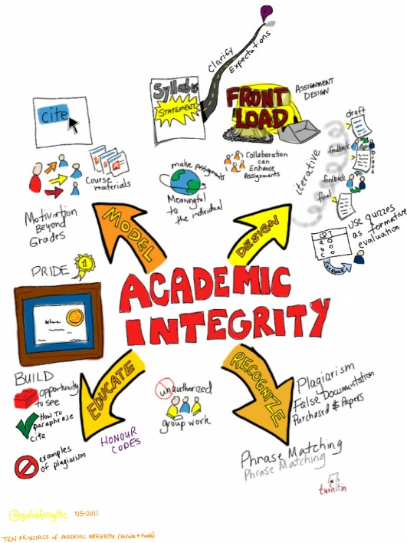
Academic Integrity Policy
Complete your own work at all times.
Academic Dishonesty or “cheating” means using some or all of another person’s work as your own.
Copying information/answers from another student/website and submitting as your own,
plagiarizing
Allowing another student to copy your work
Excessive collaboration on an assignment meant to be done individually
Sharing test/quiz questions/answers with student(s) who have not taken the test/quiz

Slide 10
Academic Integrity Policy
Students caught violating these guidelines will receive disciplinary action according to the following classroom policy
1st offense: student/teacher conference & no credit or partial credit for redo
2nd offense: student/teacher/parent conference & no credit for the assignment – no opportunity to redo
3rd offense: Involvement of Dean of Students and potential loss of credit for course

Slide 11
Attendance and Make-up Work Policy
Absences happen and we understand – ASU Prep follows a Maroon and Gold block scheduled which means each day you are absent you miss the equivalent of two days work.
Please schedule a time to meet with me to find out what you missed and I recommend you check-in with me via email and/or check the class website to see what you are missing.
You have 2 calendar days to make up absent work – a zero will be recorded until absent work is received.

Slide 12
Missing and Incomplete Assignments
Incudes in-class assignments and homework that was not turned in or was not at a satisfactory level.
Zero’s will be recorded for missing/incomplete work.
Most assignments are available for “make-up” if you meet with me to discuss the assignment first.

Slide 13
Classroom Expectations – REP THE PREP!
Be Kind, Work Hard, Be Smart
School is a place where you prepare for your future, come with a professional attitude, prepared for class and dressed for success.
Be Kind… All students will fell safe to learn. Respect, Listen, Support.
Work Hard… Our purpose at ASU Prep is to prepare you for success in college and in the community. Come prepared, challenge yourself, complete ALL assignments on time and to the best of your ability, ask for help when needed.
Be Smart… Come to school every day and be on time, make good decisions, follow the rules.

Slide 14
Classroom Procedures – REP THE PREP!
Class Arrival
Bathroom
Food/Drink in Class
Lotions/Make-up/Body Sprays
Uniform and Dress Code Policy
Phones and Electronic Devices
Absences/Missing Work
Homework
Group Work
Class Discussions
Class Presentations
Nurse or Other Concerns
Seating Assignment
Sub-Days
Tutoring
Class Binder, Handouts, Class Notes

Slide 15
Signature
Sign, have your parents sign and return signed document by the end of the week…

